Slide 1
Stack Implementations
Chapter 6
Data Structures and Abstractions with Java, 4e
Frank Carrano
© 2015 Pearson Education, Inc., Upper Saddle River, NJ. All rights reserved.

Slide 2
Linked Implementation
Each operation involves top of stack
  push
  pop
  peek
Head of linked list easiest, fastest to access
  Let this be the top of the stack
© 2015 Pearson Education, Inc., Upper Saddle River, NJ. All rights reserved.

Slide 3
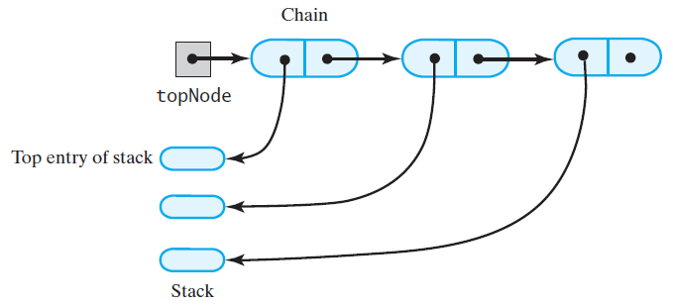
Linked Implementation
FIGURE 6-1 A chain of linked nodes
that implements a stack
© 2015 Pearson Education, Inc., Upper Saddle River, NJ. All rights reserved.

Slide 4
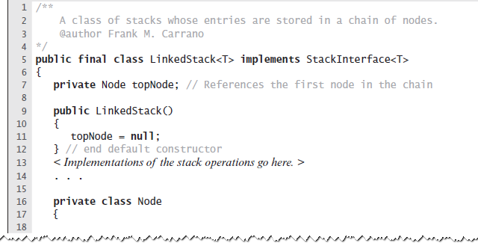
Linked Implementation
LISTING 6-1 An outline of a linked implementation
of the ADT stack
© 2015 Pearson Education, Inc., Upper Saddle River, NJ. All rights reserved.

Slide 5
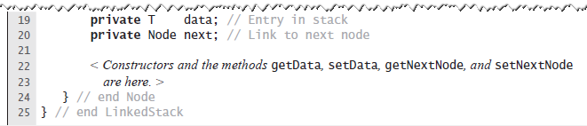
Linked Implementation
LISTING 6-1 An outline of a linked implementation
of the ADT stack
© 2015 Pearson Education, Inc., Upper Saddle River, NJ. All rights reserved.

Slide 6
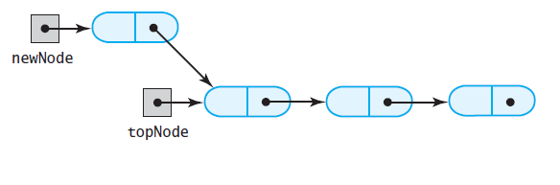
Linked Implementation
(a)
FIGURE 6-2 (a) A new node that references
the node at the top of the stack;
© 2015 Pearson Education, Inc., Upper Saddle River, NJ. All rights reserved.

Slide 7
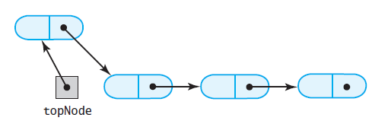
Linked Implementation
(b)
FIGURE 6-2 (b) the new node is now at the top of the stack
© 2015 Pearson Education, Inc., Upper Saddle River, NJ. All rights reserved.

Slide 8
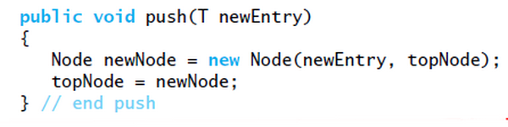
Linked Implementation
Definition of push
© 2015 Pearson Education, Inc., Upper Saddle River, NJ. All rights reserved.

Slide 9
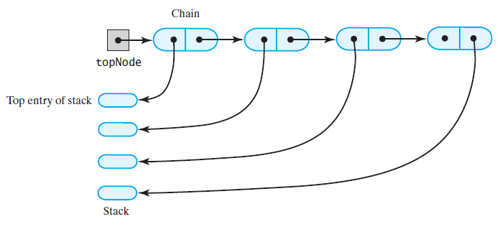
Linked Implementation
(a)
FIGURE 6-3 The stack (a) before the
first node in the chain is deleted
© 2015 Pearson Education, Inc., Upper Saddle River, NJ. All rights reserved.

Slide 10
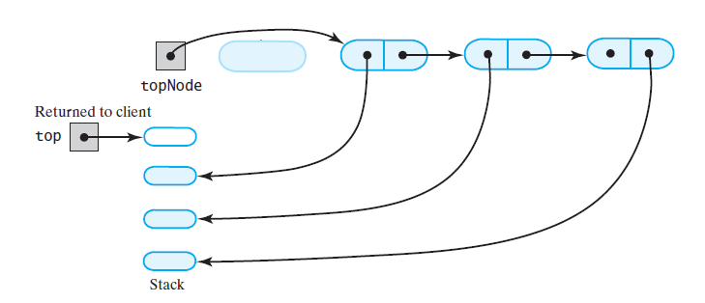
Linked Implementation
(b)
FIGURE 6-3 The stack (b) after the
first node in the chain is deleted
© 2015 Pearson Education, Inc., Upper Saddle River, NJ. All rights reserved.

Slide 11
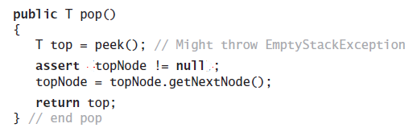
Linked Implementation
Definition of pop
© 2015 Pearson Education, Inc., Upper Saddle River, NJ. All rights reserved.

Slide 12
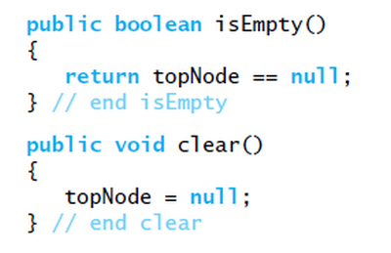
Linked Implementation
Definition of rest of class.
© 2015 Pearson Education, Inc., Upper Saddle River, NJ. All rights reserved.

Slide 13
Array-Based Implementation
Each operation involves top of stack
  push
  pop
  peek
End of the array easiest to access
  Let this be top of stack
  Let first entry be bottom of stack
© 2015 Pearson Education, Inc., Upper Saddle River, NJ. All rights reserved.

Slide 14
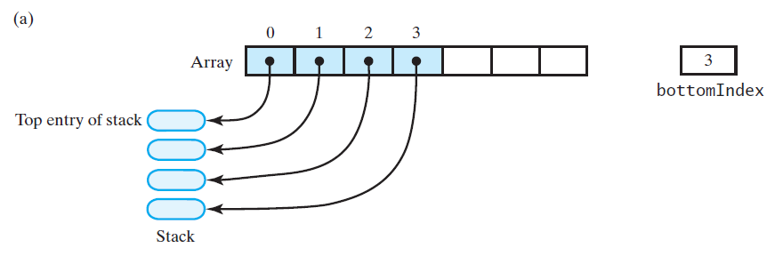
Array-Based Implementation
FIGURE 6-4 An array that implements a stack; its first location references (a) the top entry in the stack;
© 2015 Pearson Education, Inc., Upper Saddle River, NJ. All rights reserved.

Slide 15
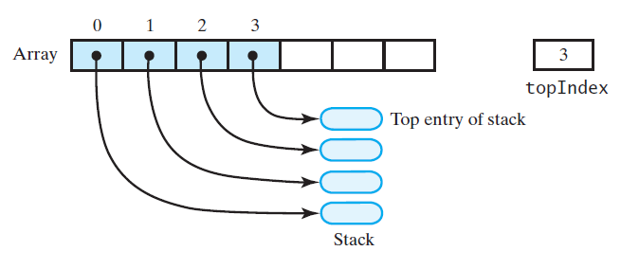
Array-Based Implementation
(b)
FIGURE 6-4 An array that implements a stack; its first location references (b) the bottom entry in the stack
© 2015 Pearson Education, Inc., Upper Saddle River, NJ. All rights reserved.

Slide 16
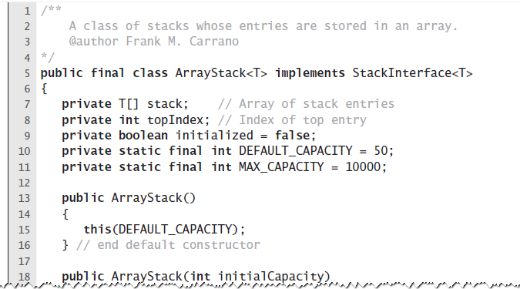
Array-Based Implementation
LISTING 6-2 An outline of an array-based
implementation of the ADT stack
© 2015 Pearson Education, Inc., Upper Saddle River, NJ. All rights reserved.

Slide 17
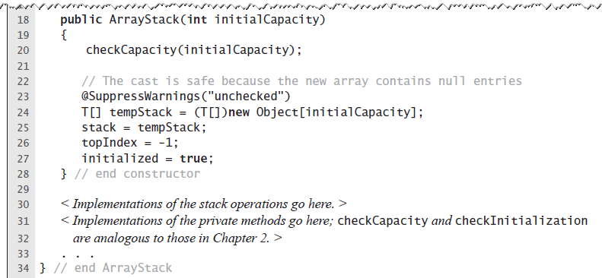
Array-Based Implementation
LISTING 6-2 An outline of an array-based
implementation of the ADT stack
© 2015 Pearson Education, Inc., Upper Saddle River, NJ. All rights reserved.

Slide 18
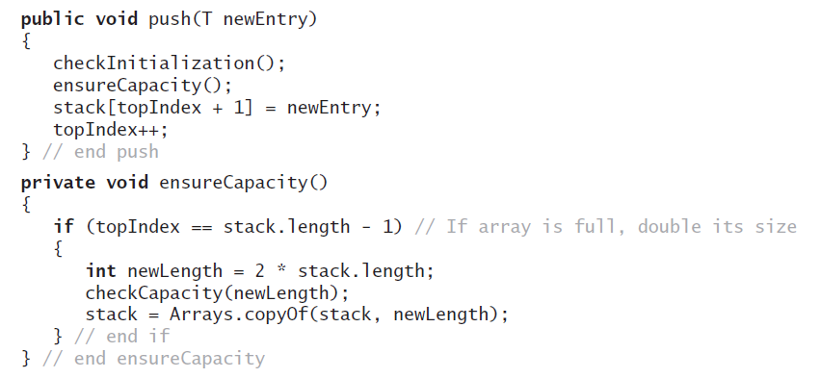
Array-Based Implementation
Adding to the top.
© 2015 Pearson Education, Inc., Upper Saddle River, NJ. All rights reserved.

Slide 19
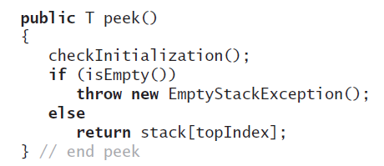
Array-Based Implementation
Retrieving the top, operation is O(1)
© 2015 Pearson Education, Inc., Upper Saddle River, NJ. All rights reserved.

Slide 20
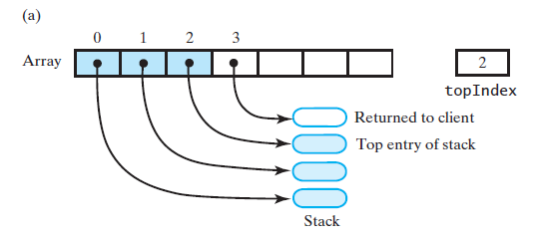
Array-Based Implementation
FIGURE 6-5 An array-based stack after its top entry is removed by (a) decrementing topIndex;
© 2015 Pearson Education, Inc., Upper Saddle River, NJ. All rights reserved.

Slide 21
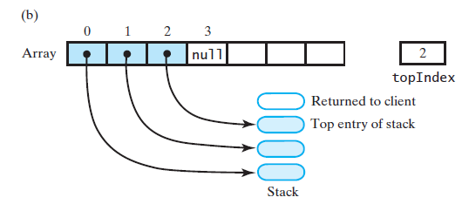
Array-Based Implementation
FIGURE 6-5 An array-based stack after its top entry is removed by (b) setting stack[topIndex] to null and then decrementing topIndex
© 2015 Pearson Education, Inc., Upper Saddle River, NJ. All rights reserved.

Slide 22
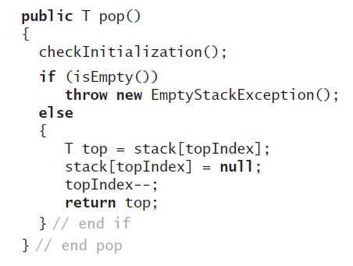
Array-Based Implementation
Removing the top
© 2015 Pearson Education, Inc., Upper Saddle River, NJ. All rights reserved.

Slide 23
Vector Based Implementation
Vector: an object that behaves like a high-level array
  Index begins with 0
  Methods to access or set entries
  Size will grow as needed
Use vector’s methods to manipulate stack
© 2015 Pearson Education, Inc., Upper Saddle River, NJ. All rights reserved.

Slide 24
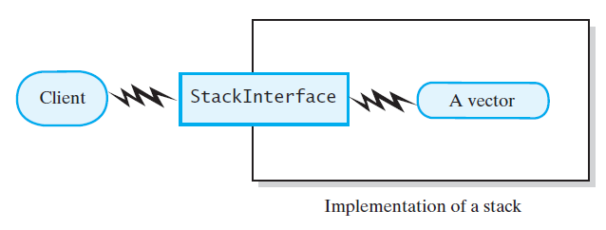
Vector Based Implementation
FIGURE 6-6 A client using the methods given in StackInterface; these methods interact with a vector’s methods to perform stack operations
© 2015 Pearson Education, Inc., Upper Saddle River, NJ. All rights reserved.

Slide 25
The Class Vector
Constructors
Has methods to add, remove, clear
Also methods to determine
  Last element
  Is the vector empty
  Number of entries
© 2015 Pearson Education, Inc., Upper Saddle River, NJ. All rights reserved.

Slide 26
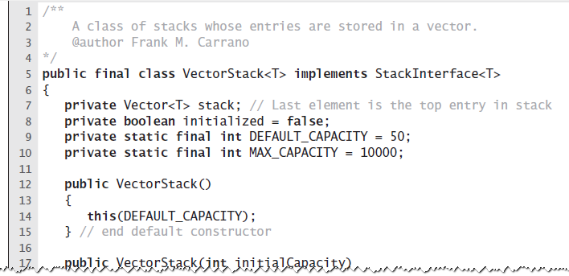
Vector Based Implementation
LISTING 6-3 An outline of a vector-based
implementation of the ADT stack
© 2015 Pearson Education, Inc., Upper Saddle River, NJ. All rights reserved.

Slide 27
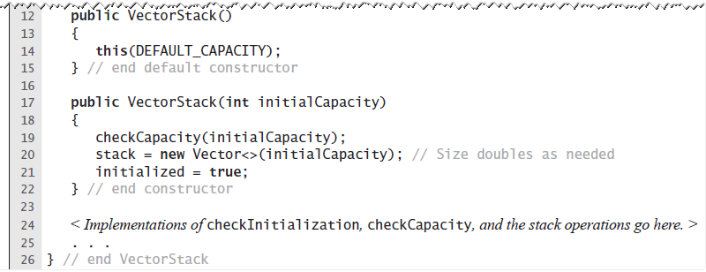
Vector Based Implementation
LISTING 6-3 An outline of a vector-based
implementation of the ADT stack
© 2015 Pearson Education, Inc., Upper Saddle River, NJ. All rights reserved.

Slide 28
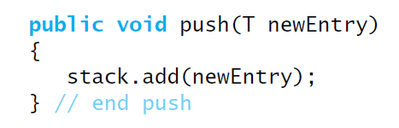
Vector Based Implementation
Adding to the top
© 2015 Pearson Education, Inc., Upper Saddle River, NJ. All rights reserved.

Slide 29
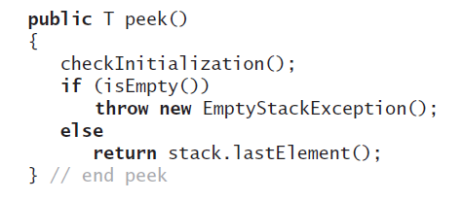
Vector Based Implementation
Retrieving the top
© 2015 Pearson Education, Inc., Upper Saddle River, NJ. All rights reserved.

Slide 30
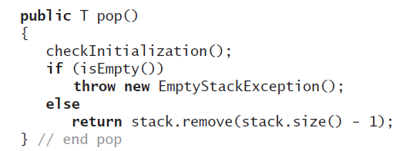
Vector Based Implementation
Removing the top
© 2015 Pearson Education, Inc., Upper Saddle River, NJ. All rights reserved.

Slide 31
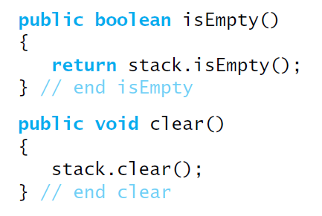
Vector Based Implementation
The rest of the class.
© 2015 Pearson Education, Inc., Upper Saddle River, NJ. All rights reserved.

Slide 32
Stack Implementations
Chapter 6
© 2015 Pearson Education, Inc., Upper Saddle River, NJ. All rights reserved.

